Slide 1
Fake Job Posting Prediction Khandesh Education Society’s, PRATAP COLLEGE, AMALNER (AUTONOMOUS)

Slide 2
Fake Job Posting Prediction
INTRODUCTION :
The current market situation has led to high unemployment. Economic stress and the impact of the coronavirus have significantly reduced job availability and the loss of jobs for many individuals.
This is an appropriate opportunity for scammers to scam individuals who have lost their jobs in this situation.
Most scammer do this to get personal information from the person they are scamming. Personal information can contain address, bank account details, social security number etc.
The scammers provide users with a very lucrative job opportunity and later ask for money in return.

Slide 3
Problem Statement :
Nowadays, there are lots of jobs posted online or on platforms such as Linkedin and Handshake. However, among the large number of jobs posted online, some of them are completely fake, and some of them have misleading or unmatched information regarding the salary packages or the benefits. Identifying these posts can help job-applicants avoid scams and improve the integrity of online hiring.

Slide 4
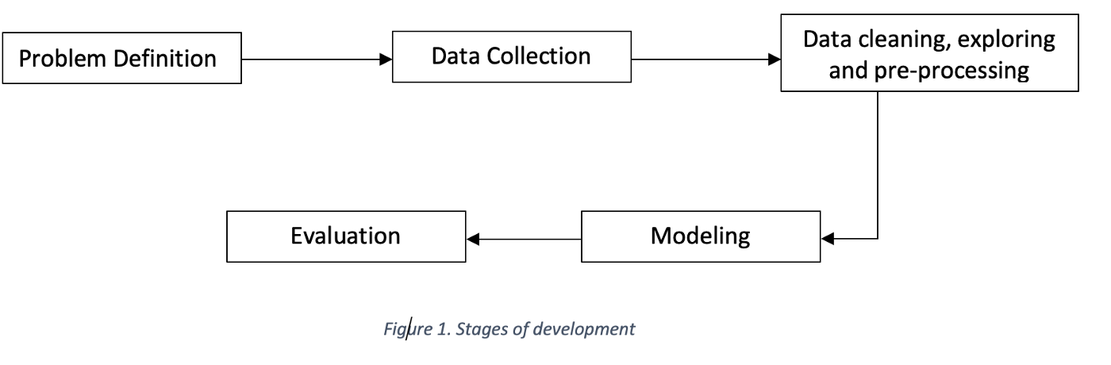
Project Stages :
Data Pre-processing :
NLP:-
Normalization
Tf Idf
Modeling :
Machine Learning :-
Logistic Regression
Support Vector Machine(SVM)
Decision Tree
Random Forest

Slide 5
Result:
The accuracy scores of random forest and support vector machine (SVM) are giving us same accuracy scores.
The final model used for this analysis is – Random Forest, this is based on the results of the accuracy scores. The outcome of the logistic regression, support vector machine, decision tree and random forest are presented in the table below:
Model Names | Accuracy Scores
Logistic Regression | 0.976
Support Vector Machine | 0.985
Decision Tree | 0.979
Random Forest | 0.985

Slide 6
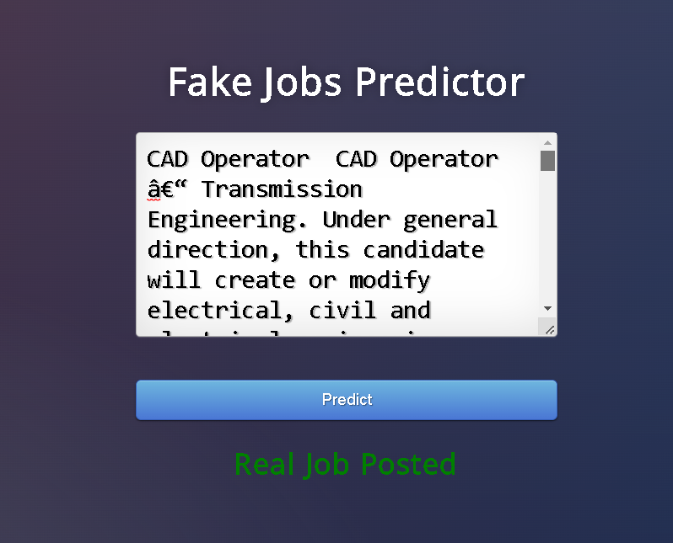
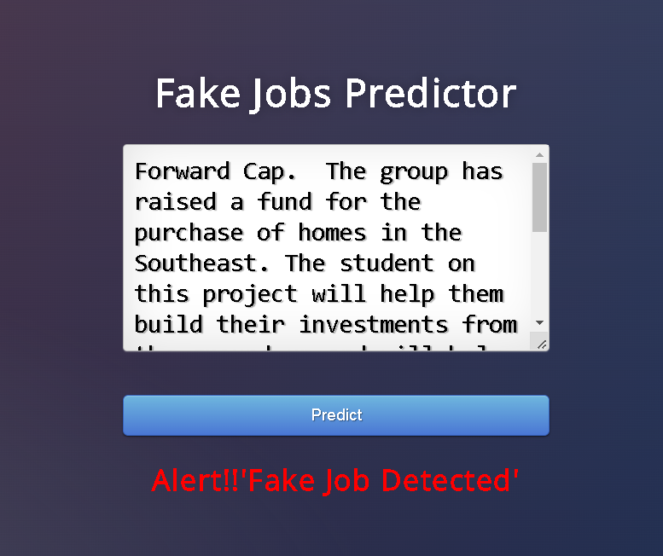
Implementation of Model:

Slide 7
Conclusion :
Fake job postings are an important real-world challenge that require active solutions. This project aims to provide a potential solution to this problem. The textual data is pre-processed to generate optimal results and relevant numerical fields are chose as well. The output of Multiple models are compare to produce the best possible results.

Slide 8
Future Scope :
The future, if any industry wants employ these models to the practical circumstances or other related datasets about the fraudulence job posts prediction, we suggest to use the hyperparameters tuned logistic regression.

Slide 9
REFERENCES:
Honnibal, M., Montani, I., Van Landeghem, S., Boyd, A.: spaCy: Industrial-strength Natural Language Processing in Python (2020).
Pennington, J., Socher, R., Manning, C.D.: Glove: Global vectors for word representation. In: Empirical Methods in Natural Language Processing (EMNLP). pp. 1532–1543 (2014), http://www.aclweb.org/anthology/D14-1162
Vidros, S., Kolias, C., Kambourakis, G., Akoglu, L.: Automatic detection of online recruitment frauds: Characteristics, methods, and a public dataset. Future Internet 9(1) (2017).

Slide 10
Thank you

